Slide 1
MazeSolver
Capstone Development Phase 2
Created by Marcus Klein
Mentor: Dr. Kevin Cherry
www.github.com/mklein530/MazeSolver

Slide 2
Project Overview
Phase 1 Recap
Phase 2 Tasks
Project Visual
Concepts Learned
Phase 3 Plans

Slide 3
Project overview
A user customizable maze created using computer graphics
OpenGL for graphics
C++ programming language
Artificial Intelligence / Pathfinding used to solve the given maze
Various algorithms will be experimented with

Slide 4
Phase 1 Recap
Gain familiarity with OpenGL and C++
Tutorials, books, etc. - Interactive Computer Graphics, nehe.gamedev.net
Creating windows
Drawing shapes
C++ basics
Standard Template Library
Create Maze

Slide 5
Phase 2 GOALS
Become more familiar with C++
C++ Primer by Stanley Lippman
Online C++ Reference
Experiment with different pathfinding algorithms
BFS, DFS, Dijkstra’s Algorithm

Slide 6
Phase 2 Tasks
Learn C++
Ongoing throughout the entire project
Modern C++: C++11 and C++14
C++ Primer
Code refactoring
Clean up code from phase one
Abstract the code – generalize as much as possible
Makes future modifications easier
Also an ongoing task

Slide 7
Phase 2 tasks Continued
Learn pathfinding algorithms
BFS, DFS, Dijkstra’s Algorithm
Implement pathfinding algorithms
Breadth-first implemented
Depth-first implemented
Dijkstra’s Algorithm in progress

Slide 8
Algorithm Pseudocode
Breadth-first search
Create empty queue Q
Q.enqueue(start)
While Q is not empty:
current = Q.dequeue()
for each node n that is adjacent to current
if n has not been visited
n.setVisited(true)
n.setParent(current)
Q.enqueue(n)

Slide 9
Pseudocode Continued
Depth-first search
Create empty stack S
S.push(start)
while S is not empty
v = S.pop()
if v has not been visited
v.setVisited(true)
for each unvisited adjacent node n of v
n.setParent(v)
S.push(n)

Slide 10
Finding A path
Create a tree of nodes, where the parent of each node is the node that added it to the stack or queue in DFS or BFS, respectively
Once the goal node is found, traverse up the tree to each parent until the start node is reached
Shortest path guaranteed in BFS, not in DFS

Slide 11
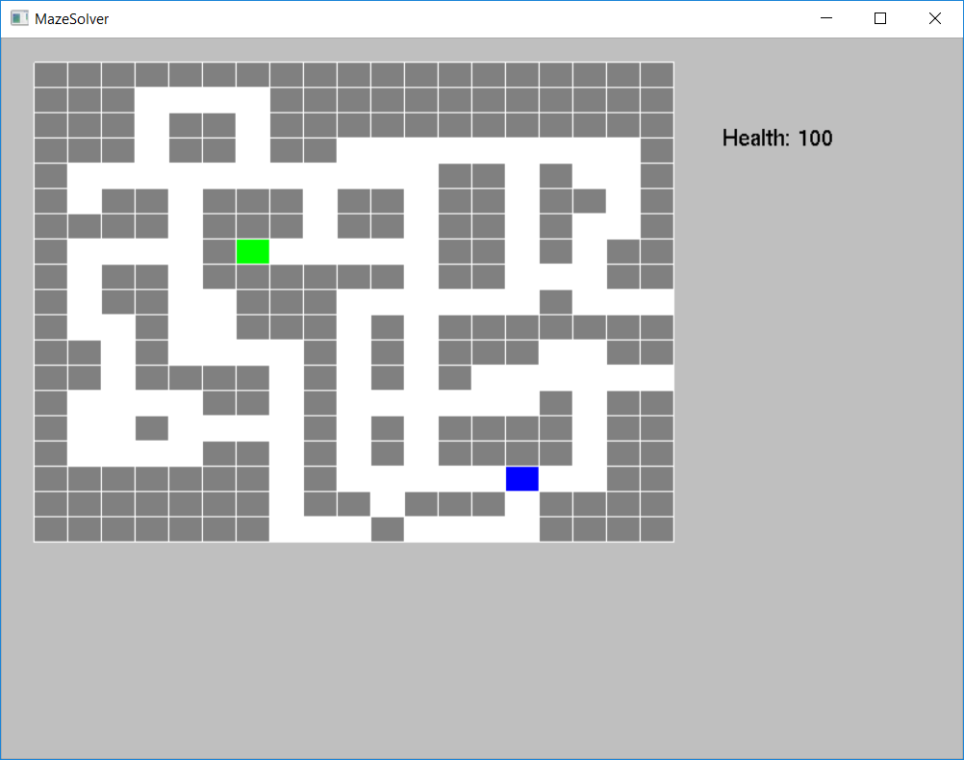
Phase 2 Maze
Blue – start node
Green – goal node

Slide 12
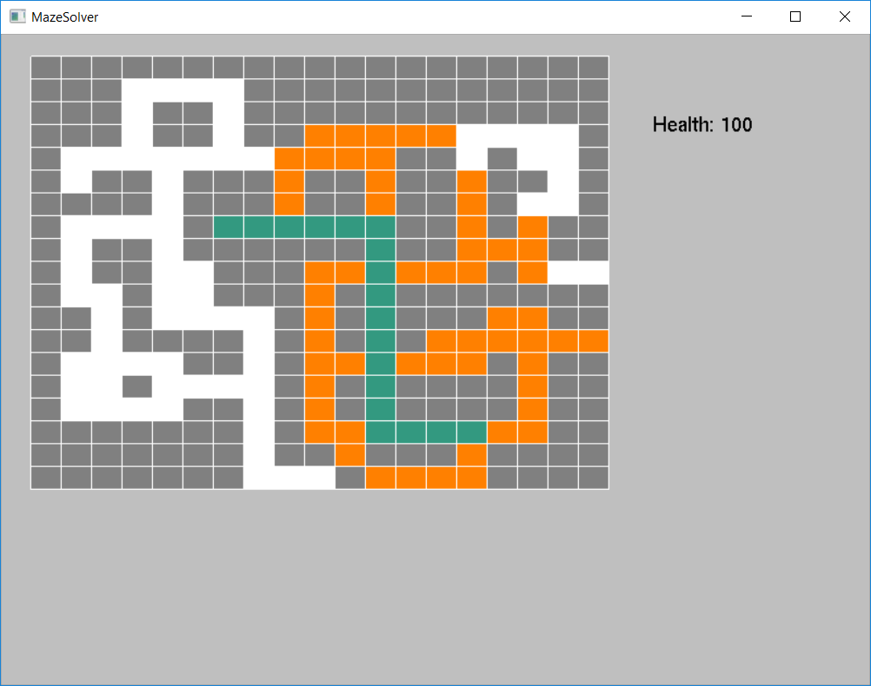
Solved Maze
Orange – all visited nodes
Dark Green – path from start node to goal node
Solved using BFS

Slide 13
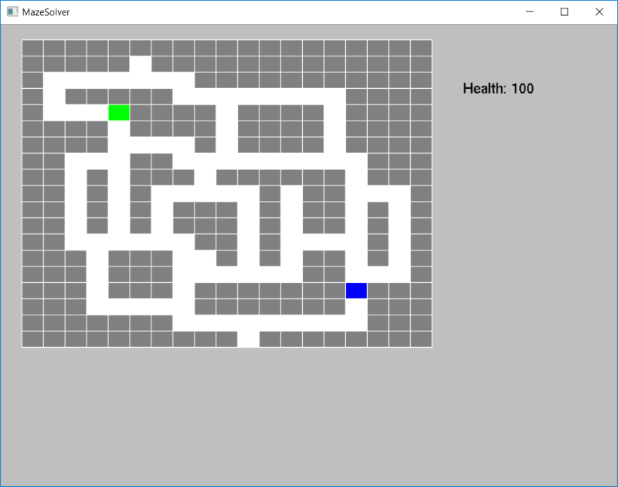
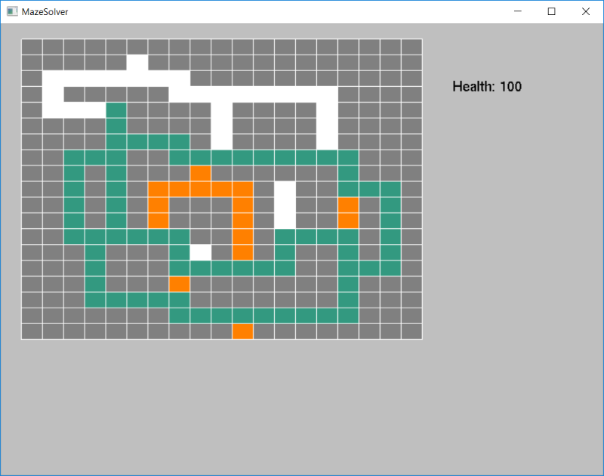
Solved Maze
Orange – all visited nodes
Dark Green – path from start node to goal node
Solved using DFS

Slide 14
Concepts learned
C++
References and pointers
References are similar to pointers but safer
int j = 0;
int& k = j; //k is an alias for j
References cannot be made to refer to another object once created
STL containers
Lists, vectors, queues, priority queues, stacks
Auto
Type deduced from initialization expression
int j = 0
auto m = j; //auto is of type int

Slide 15
Concepts learned
Graph / pathfinding algorithms
BFS
DFS
Dijkstra’s algorithm

Slide 16
Phase 3 Plans
Continuous refactoring
Learn more C++
Learn neural networks and/or genetic algorithm and begin implementing one

